Slide 1
ADVANCED WEB TECHNOLOGIES UNIT – IV
Shreya J Shetty
Assistant Professor Gd – I
Department of MCA

Slide 2
1.Introduction to dynamic documents
Dynamic HTML is not a new markup language but a combination of technologies.
It allows dynamic changes in HTML documents after the page is loaded.
Changes can be made to tag attributes, contents, or style properties.
These changes occur due to user interaction such as clicking buttons or moving the mouse.
Changes can also occur due to browser events like load, unload, or resize.
Dynamic documents use client-side JavaScript to modify webpage elements.
Elements of the HTML document are accessed as objects using the DOM structure.
Browser support for Dynamic HTML is not uniform across all browsers.

Slide 3
2.Positioning Elements
Earlier, HTML elements were arranged one below another with little control over placement.
HTML tables were used for layout but they were not flexible and slow.
Cascading Style Sheets Positioning solved this problem.
CSS positioning allows elements to be placed anywhere on the page.
Elements can also be moved dynamically using JavaScript.
CSS positioning mainly uses position, top, and left properties.
The position property has three values: absolute, relative, static.

Slide 4
2.1. Absolute Positioning
An element is placed at a specific location on the page.
It is positioned without considering other elements.
The location is defined using top and left.
Absolutely positioned elements can overlap other elements.
The position is measured from the browser window or parent element.
Example:
<p style="position:absolute; left:100px; top:200px;">
Text
</p>

Slide 5
2.2 Relative Positioning
The element is first placed in its normal position.
It is then moved relative to its original position.
The original space of the element is preserved.
top and left shift the element from its normal position.
Used for small adjustments like superscripts or special effects.
Example:
<span style="position:relative; left:50px;">
GOOD
</span>

Slide 6
2.3 Static Positioning
Static is the default value of the position property.
Elements appear in normal document flow.
top and left properties do not affect static elements.
Static elements cannot be moved from their position.

Slide 7
3 Moving Elements
As stated previously, an HTML element whose position property is set to either absolute or relative can be moved.
Moving an element is simple: Changing the top or left property values causes the element to move on the display.
If its position is set to absolute, the element moves to the new values of top and left.
If its position is set to relative, it moves from its original position by distances given by the new values of top and left.
Example:movingele.html

Slide 8
4. Element Visibility
Elements in a webpage can be shown or hidden using the visibility property.
The two values of visibility are visible and hidden.
visible → element is displayed.
hidden → element is not displayed.
JavaScript can change visibility dynamically.
A button can be used to toggle visibility.
Example:visibility.html

Slide 9
5 Changing Colors and Fonts
The background and foreground colors of the document display can be dynamically changed
5.1 Changing Colors
Dynamic changes to colors are relatively simple.
In the next example, the user is presented with two text boxes into which color specifications can be typed—one for the document background color and one for the foreground color.
The colors can be specified in any of the three ways that color properties can be given in CSS.
A JavaScript function that is called whenever one of the text boxes is changed makes the change in the document’s appropriate color property: backgroundColor or color.
The first of the two parameters to the function specifies whether the new color is for the background or foreground; the second specifies the new color. The new color is the value property of the text box that was changed by the user.
Eg - color change.html

Slide 10
5.2 Changing Fonts
Web users are accustomed to having links in documents change color when the cursor is placed over them.
Use of the mouseover event to trigger a JavaScript event handler allows us to change any property of any element in a document, including text, when the mouse cursor is placed over it.
Thus, the font style and font size, as well as the color and background color of text, can be changed when the cursor is placed over the text.
The text can be changed back to its original form when an event handler is triggered with the mouseout event.
For CSS attribute names that are single words without hyphens ie property value font-size and CSS value is fontSize.
Eg – font change.html

Slide 11
6 Dynamic Content
Changing the content of HTML elements.
The content of an element is accessed through the value property of its associated JavaScript object.
So, changing the content of an element is not essentially different from changing the style properties of the element.
Example
Assistance to a browser user filling out a form can be provided with an associated text area, often called a help box.
The content of the help box can change, depending on the placement of the mouse cursor.
Eg – dynamic.html

Slide 12
7. Stacking Elements
The top and left properties are used to place an element at any position on the web page. These properties move elements in the horizontal and vertical directions.
When elements are positioned using CSS, they can overlap each other, creating the effect of a third dimension (front and back) even though the screen is two-dimensional.
Multiple elements can occupy the same location on the page, but only one element is visible on top while the others remain partially or completely hidden.
The stacking order of overlapping elements is controlled using the z-index property in CSS.
An element that has a higher z-index value is displayed above elements that have lower z-index values, thereby hiding them.
In JavaScript, the CSS z-index property is accessed using the zIndex style property, and the value assigned to it is treated as a string.
Example:stacking.html

Slide 13
8. Locating the Mouse Cursor
Every mouse click generates an event object that stores information about the event.
The Mouse Event provides coordinates of the mouse cursor position.
clientX and clientY give cursor coordinates relative to the browser window.
screenX and screenY give cursor coordinates relative to the computer screen.
The event object is passed to the handler function using event parameter.
JavaScript reads these values and displays them in text boxes when the mouse is clicked.
Example:lmc.html

Slide 14
9. Reacting to a Mouse Click
The mousedown event occurs when the mouse button is pressed.
The mouseup event occurs when the mouse button is released.
In this example, a message is displayed when the mouse is pressed.
The message disappears when the mouse button is released.
The cursor position is obtained using clientX and clientY.
The message is positioned near the cursor using left and top style properties.
Example:rmc.html

Slide 15
10 Slow Movement of Elements
Instant movement happens by directly changing top and left values.
Slow movement is done by moving element in small steps repeatedly.
The setTimeout() method executes code after a specified delay.
The setInterval() method executes code repeatedly at fixed intervals.
The element is moved by changing left and top values gradually.
Animation continues until the element reaches the final position.
Example:slowmovements.html

Slide 16
11 Dragging and Dropping Elements
One of the more powerful effects of event handling is allowing the user to drag and drop elements around the display screen.
The mouseup, mousedown, and mousemove events can be used to implement this feature.
This example uses a mixture of the DOM 0 and DOM 2 event models.
The DOM 0 model is used for the call to the handler for the mousedown event.
The rest of the process is designed with the DOM 2 model.

Slide 17
Introduction to jQuery
jQuery makes it easier to use JavaScript on websites.
It is a lightweight JavaScript library based on "write less, do more".
jQuery reduces complex JavaScript coding into simple method calls.
Tasks that require many lines of JavaScript can be done in a single line.
It simplifies complicated operations like AJAX and DOM manipulation.
Many JavaScript libraries are available, but jQuery is the most popular and extendable.

Slide 18
Adding jQuery to Your Web Pages
There are several ways to start using jQuery in a website.
jQuery can be downloaded from the official jQuery website.
The Production version is minified and compressed, used for live websites.
The Development version is uncompressed and readable, used for testing.
The jQuery library is a single JavaScript file.
It is added to HTML using the <script> tag inside the <head> section.
<head> <script src="jquery-3.7.1.min.js"></script> </head>
jQuery can also be included using a CDN (Content Delivery Network).
<head> <script src="https://ajax.googleapis.com/ajax/libs/jquery/3.7.1/jquery.min.js"></script> </head>

Slide 19
jQuery Syntax
jQuery syntax is used to select HTML elements and perform actions on them.
The basic syntax of jQuery is $(selector).action()
The $ sign is used to access jQuery.
The selector is used to find HTML elements.
The action() defines the operation to be performed on selected elements.
Examples:
$(this).hide() – hides the current element.
$("p").hide() – hides all <p> elements.
$(".test").hide() – hides all elements with class="test".
$("#test").hide() – hides the element with id="test".

Slide 20
jQuery methods are written inside the document ready event.
The syntax is
$(document).ready(function(){
// jQuery methods go here...
});
It ensures that jQuery code runs only after the document is fully loaded.
This prevents errors caused by accessing elements before they exist.
Here are some examples of actions that can fail if methods are run before the document is fully loaded:
Trying to hide an element that is not created yet
Trying to get the size of an image that is not loaded yet
It is good practice to wait until the page is ready before using jQuery.
It allows JavaScript code to be placed inside the <head> section.
A shorter syntax for document ready event is
$(function(){
// jQuery methods go here...
});

Slide 21
jQuery Selectors
jQuery selectors are used to select and manipulate HTML elements.
They help in finding elements based on name, id, class, type, attributes, and values.
jQuery selectors are based on CSS selectors.
jQuery also provides some additional custom selectors.
All jQuery selectors start with $().
Element Selector
The element selector selects elements based on the element name.
Example: $("p") selects all <p> elements on the page.
jQuery can perform actions on selected elements.
$(document).ready(function(){
$("button").click(function(){
$("p").hide();
});
});

Slide 22
jQuery #id Selector
The #id selector uses the id attribute to find a specific HTML element.
An id is always unique within a web page.
The #id selector is used to select a single element.
It is written using a hash # followed by the id name.
Example: $("#test") selects the element with id="test".
$(document).ready(function(){
$("button").click(function(){
$("#test").hide();
});
});

Slide 23
jQuery .class Selector
The .class selector is used to find elements with a specific class.
It selects all elements that share the same class name.
The class selector is written using a period . followed by the class name.
Example: $(".test") selects all elements with class="test".
$(document).ready(function(){
$("button").click(function(){
$(".test").hide();
});
});

Slide 24
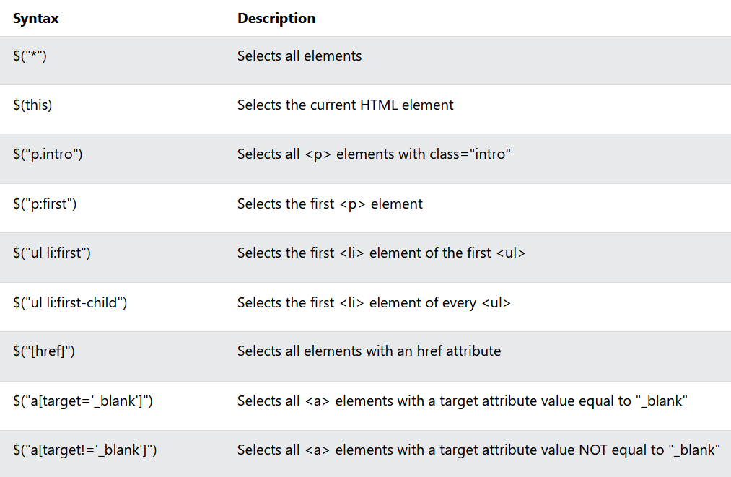
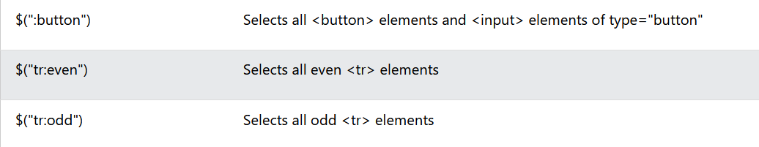
More Examples of jQuery Selectors

Slide 25
Functions in a Separate File
jQuery functions can be placed in a separate .js file.
This is useful when a website contains many pages.
It makes the code easier to maintain and manage.
The separate file is linked using the <script> tag.
The src attribute is used to refer to the external .js file.
jQuery library should be included before the custom .js file.
<head> <script src="https://ajax.googleapis.com/ajax/libs/jquery/3.7.1/jquery.min.js"></script> <script src="my_jquery_functions.js"></script> </head>

Slide 26
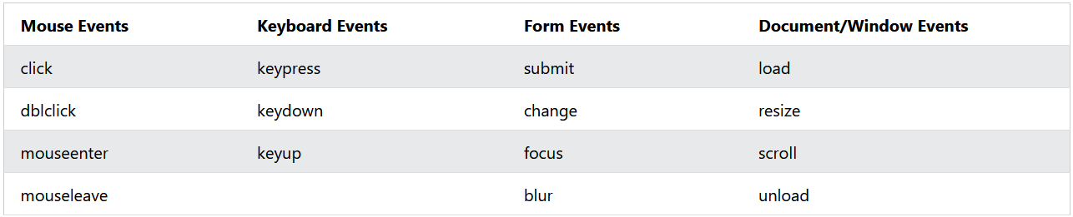
jQuery Event Methods
All the different visitors' actions that a web page can respond to are called events.
An event represents the precise moment when something happens.
Here are some common DOM events:

Slide 27
jQuery Syntax For Event Methods
In jQuery, most DOM events have an equivalent jQuery method.
To assign a click event to all paragraphs on a page, you can do this:
$("p").click();
The next step is to define what should happen when the event fires. You must pass a function to the event:
$("p").click(function(){
//actiongoeshere!!
});

Slide 28
Commonly Used jQuery Event Methods
$(document).ready()
The $(document).ready() method allows us to execute a function when the document is fully loaded.
click()
The click() method attaches an event handler function to an HTML element.
The function is executed when the user clicks on the HTML element.
$("p").click(function(){
$(this).hide();
});
dblclick()
The dblclick() method attaches an event handler function to an HTML element.
$("p").dblclick(function(){
$(this).hide();
});

Slide 29
mouseenter()
The mouseenter() method attaches an event handler function to an HTML element.
$("#p1").mouseenter(function(){
alert("You entered p1!");
});
mouseleave()
The mouseleave() method attaches an event handler function to an HTML element.
$("#p1").mouseleave(function(){
alert("Bye! You now leave p1!");
});

Slide 30
mousedown()
The mousedown() method attaches an event handler function to an HTML element.
The function is executed, when the left, middle or right mouse button is pressed down, while the mouse is over the HTML element:
$("#p1").mousedown(function(){ alert("Mouse down over p1!"); });
mouseup()
The mouseup() method attaches an event handler function to an HTML element.
$("#p1").mouseup(function(){ alert("Mouse up over p1!"); });

Slide 31
hover()
The hover() method takes two functions and is a combination of the mouseenter() and mouseleave() methods.
The first function is executed when the mouse enters the HTML element, and the second function is executed when the mouse leaves the HTML element:
$("#p1").hover(function(){
alert("You entered p1!");
},
function(){
alert("Bye! You now leave p1!");
});
focus()
The focus() method attaches an event handler function to an HTML form field.
The function is executed when the form field gets focus:
$("input").focus(function(){ $(this).css("background-color", "#cccccc"); });

Slide 32
blur()
The blur() method attaches an event handler function to an HTML form field.
The function is executed when the form field loses focus:
$("input").blur(function(){ $(this).css("background-color", "#ffffff"); });
The on() Method
The on() method attaches one or more event handlers for the selected elements.
$("p").on("click",function(){
$(this).hide();
});
Attach multiple event handlers to a <p> element:
$("p").on({
mouseenter:function(){
$(this).css("background-color","lightgray");
},
mouseleave:function(){
$(this).css("background-color","lightblue");
},
click:function(){
$(this).css("background-color","yellow");
}
});

Slide 33
jQuery Effects
Hide, Show, Toggle, Slide, Fade, and Animate.
jQuery hide() and show()
With jQuery, you can hide and show HTML elements with the hide() and show() methods.
Syntax:
$(selector).hide(speed,callback);
$(selector).show(speed,callback);
The optional speed parameter specifies the speed of the hiding/showing, and can take the following values: "slow", "fast", or milliseconds.
The optional callback parameter is a function to be executed after the hide() or show() method completes.
jQuery toggle()
You can also toggle between hiding and showing an element with the toggle() method.
$(selector).toggle(speed,callback);

Slide 34
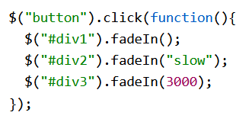
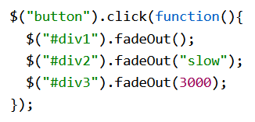
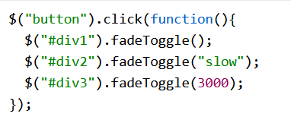
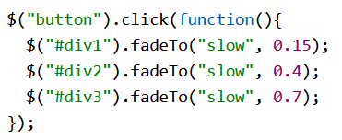
jQuery Effects - Fading
jQuery Fading Methods
With jQuery you can fade an element in and out of visibility
jQuery has the following fade methods:
fadeIn()
fadeOut()
fadeToggle()
fadeTo()
$(selector).fadeIn(speed,callback);

Slide 35
jQuery Effects - Sliding
With jQuery you can create a sliding effect on elements.
jQuery has the following slide methods:
slideDown()
slideUp()
slideToggle()
jQuery slideDown() Method
The jQuery slideDown() method is used to slide down an element.
Syntax: $(selector).slideDown(speed,callback);
$("#flip").click(function(){ $("#panel").slideDown(); });
jQuery slideUp() Method
The jQuery slideUp() method is used to slide up an element.
Syntax: (selector).slideUp(speed,callback);

Slide 36
Continued…
jQuery slideToggle() Method
The jQuery slideToggle() method toggles between the slideDown() and slideUp() methods.
If the elements have been slid down, slideToggle() will slide them up.
If the elements have been slid up, slideToggle() will slide them down.
$(selector).slideToggle(speed,callback);
$("#flip").click(function(){
$("#panel").slideToggle();
});

Slide 37
jQuery Effects - Animation
The jQuery animate() method is used to create custom animations.
Syntax: $(selector).animate({params},speed,callback);
The required params parameter defines the CSS properties to be animated.
$("button").click(function(){
$("div").animate({
left:'250px’,
opacity:'0.5’,
height:'150px’,
width:'150px’
});
});
jQuery animate() - Using Pre-defined Values
You can even specify a property's animation value as "show", "hide", or "toggle":
$("button").click(function(){ $("div").animate({ height: 'toggle' }); });

Slide 38
Continued…
jQuery animate() - Uses Queue Functionality
By default, jQuery comes with queue functionality for animations.
This means that if you write multiple animate() calls after each other, jQuery creates an "internal" queue with these method calls. Then it runs the animate calls ONE by ONE.
$("button").click(function(){
var div = $("div");
div.animate({height: '300px', opacity: '0.4'}, "slow");
div.animate({width: '300px', opacity: '0.8'}, "slow");
div.animate({height: '100px', opacity: '0.4'}, "slow");
div.animate({width: '100px', opacity: '0.8'}, "slow");
});

Slide 39
jQuery Stop Animations
The jQuery stop() method is used to stop animations or effects before it is finished.
The stop() method works for all jQuery effect functions, including sliding, fading and custom animations.
Syntax: $(selector).stop(stopAll,goToEnd);
The optional stopAll parameter specifies whether also the animation queue should be cleared or not. Default is false, which means that only the active animation will be stopped, allowing any queued animations to be performed afterwards.
The optional goToEnd parameter specifies whether or not to complete the current animation immediately. Default is false.
$(document).ready(function(){
$("#flip").click(function(){
$("#panel").slideDown(5000);
});
$("#stop").click(function(){
$("#panel").stop();
});
});

